Slide 1

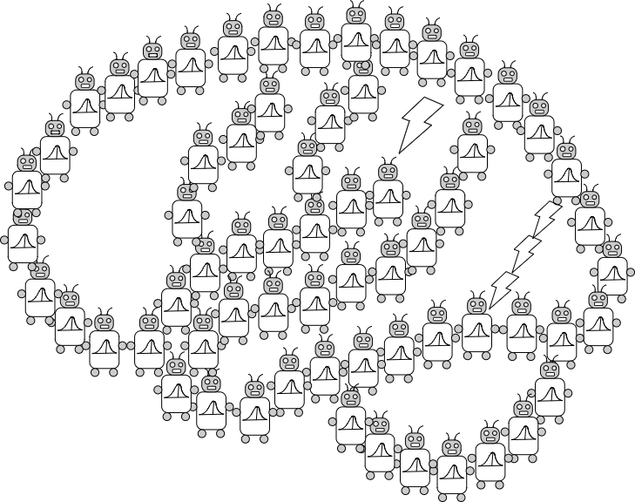
Mark Ho
Is Reinforcement Just a Value to be Maximized?
Joseph L. Austerweil
University of Wisconsin - Madison
Department of Psychology
June 28, 2021
alab.psych.wisc.edu
Notes:
Thank you for inviting me. It is a pleasure to be here. I’m excited to tell you about a line of work that my graduate student, Mark Ho, has been spearheading. This is the first time giving a cohesive talk on this line of work.
Although a lot of teaching is verbal, we also often teach in a nonverbal manner.

Slide 2
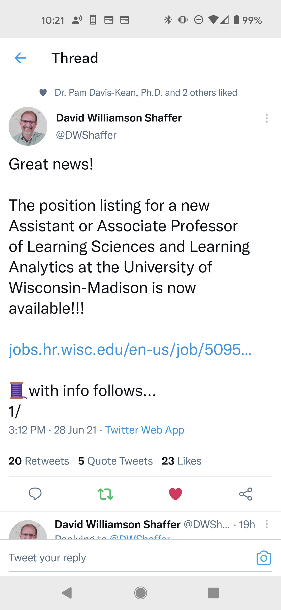

Slide 3
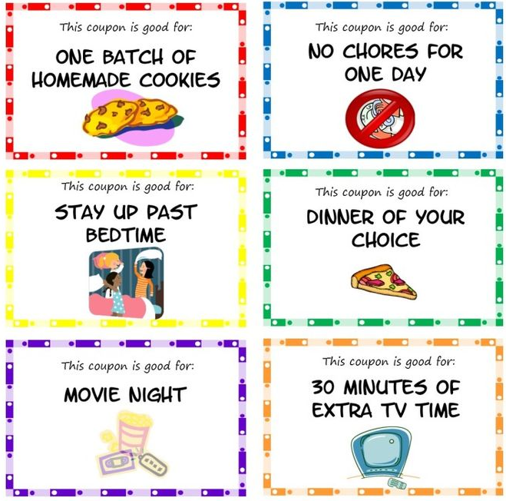
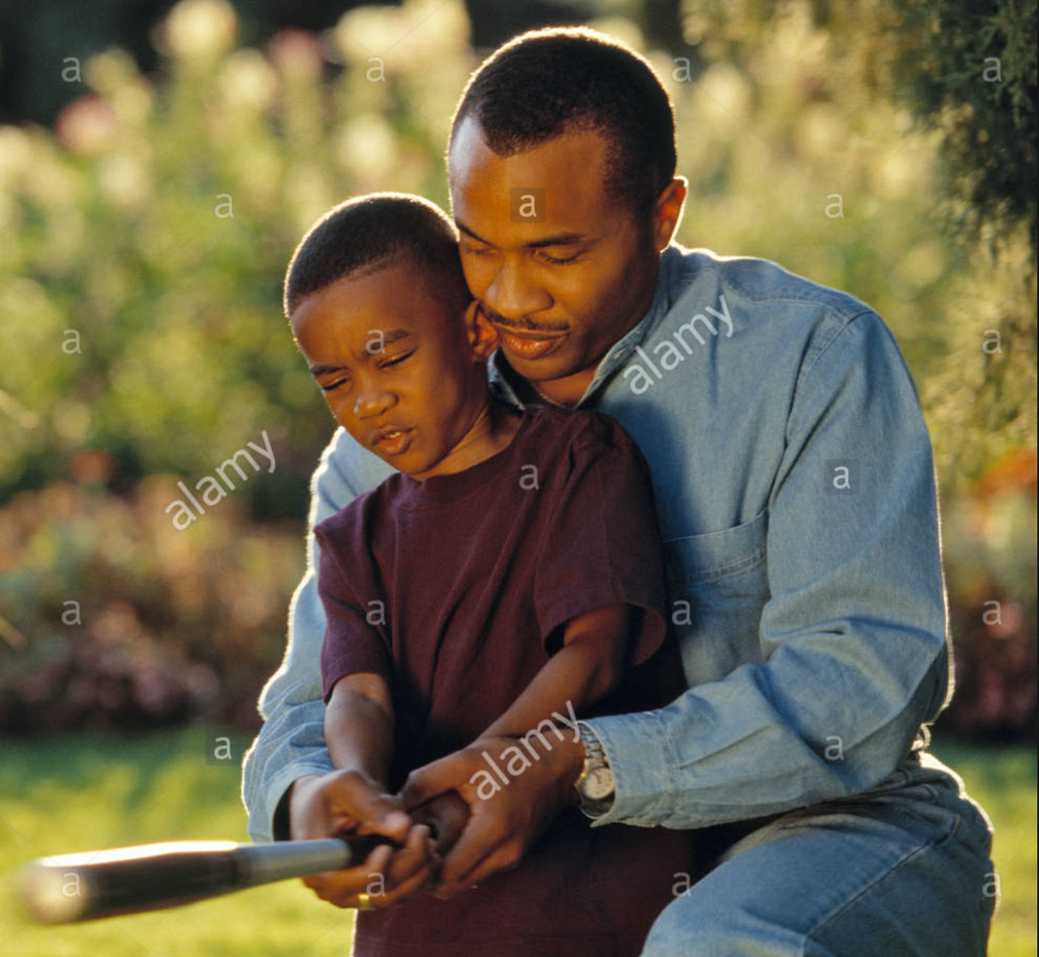


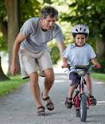
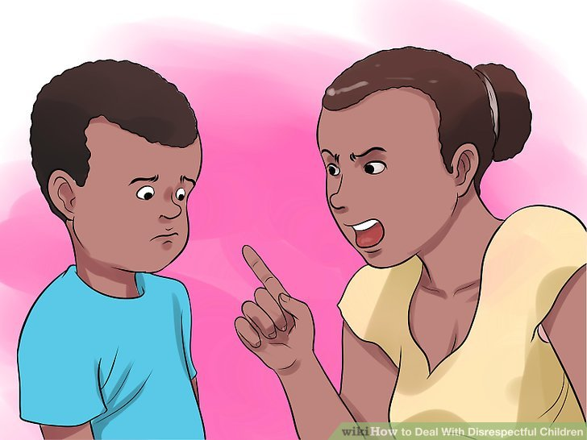
Teaching and Learning Interactions
Reward and punish behaviors
Teaching with intervention
Teaching by demonstration
Notes:
Kiran told me that I have an hour and half, but will be interrupted a lot. So going through all three parts is about 70 minutes. I’m fine with only going through two of the projects if that’s all time allows. I prepared more though in case there aren’t a lot of questions.

Slide 4
How do people represent learners when teaching them?
Reward-maximizing
I want to maximize rewards!
I got punished from my last action.
What do I do to maximize my expected reward?
I want to learn what my mom wants me to do!
I got punished from my last action.
What is my mom trying to teach me to do?
Communicating via action signaling

Slide 5
How do people represent learners when teaching them?
Reward-maximizing
I want to maximize rewards!
I got punished from my last action.
What do I do to maximize my expected reward?
I want to learn what my mom wants me to do!
I got punished from my last action.
What is my mom trying to teach me to do?
Communicating via action signaling

Slide 6
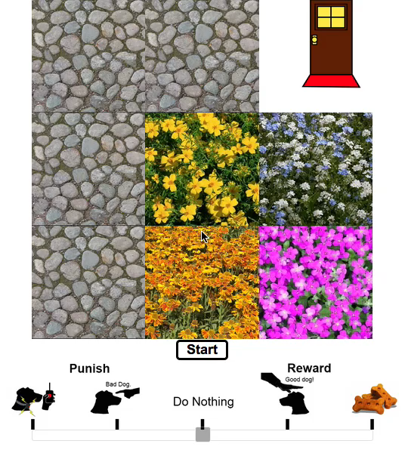
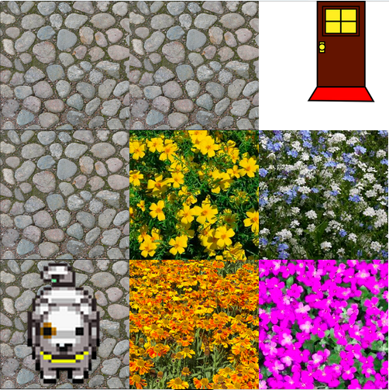
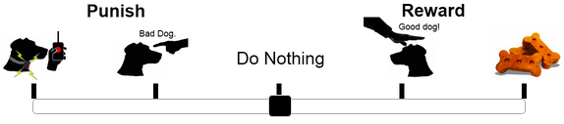
GardenPath World
States
Learner
Actions
Teacher
Feedback
Target Behavior
(which action to take in each state)
Notes:
Feedback is a valenced signal
Explain transitions

Slide 7
Reward-Maximization
π_{Reward-Max}
Teacher Feedback
Goal
Goal
Notes:
- Unit rewards and punishments

Slide 8
How do people represent learners when teaching them?
Reward-maximizing
I want to maximize rewards!
I got punished from my last action.
What do I do to maximize my expected reward?
I want to learn what my mom wants me to do!
I got punished from my last action.
What is my mom trying to teach me to do?
Communicating via action signaling

Slide 9

Action-Signaling
Feedback signals action correctness

Slide 10
Action-Signaling
Feedback signals action correctness
Policy probability given feedback
MAP policy
Feedback
likelihood
Policy
Prior

Slide 11
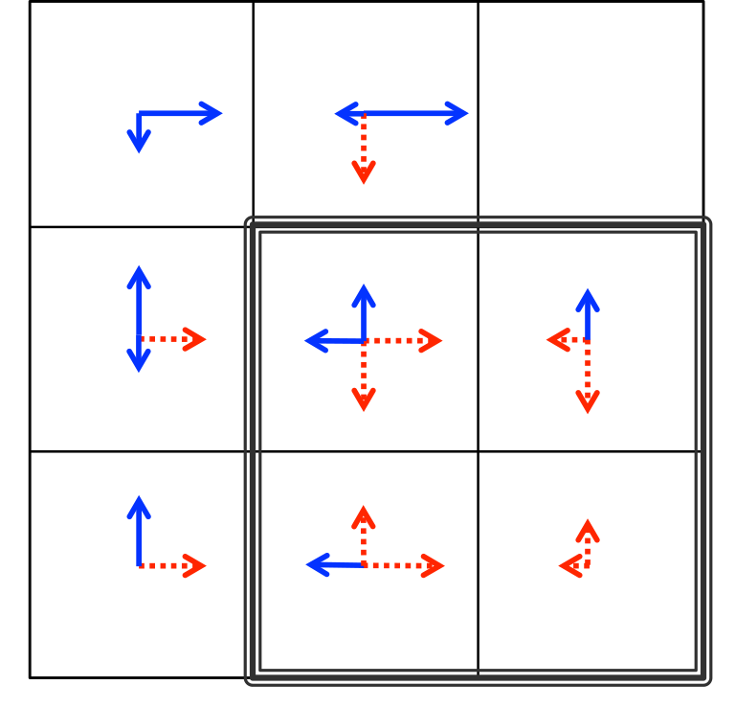
Action-Signaling
π_{Action-Signaling}
Teacher Feedback
Goal
Notes:
Bottom right goes up because fewer steps = fewer probs to multiply = larger probability

Slide 12
Exp 1: Isolated Actions
N = 39
Trained 22 individual dogs to get to door along path
Each dog performed a single distinct action
Scale normed for balance

Slide 13
Exp 1: Isolated Actions
Average Feedback

Slide 14
Results: Positive Reward Cycles
Average Feedback
Cycle
Goal
Positive Cycle (outlined): +1.20, SE = 0.2 (p < .001)
Holds at individual level (36 of 39 had this positive cycle)
38 of 39 had at least one positive cycle!

Slide 15
Expt 1

Slide 16
Questions after Experiment 1
Most learning happens during ongoing interaction
Do people adjust their teaching strategy to a reward maximizing learner?
Do people teach action-signaling agents more quickly?

Slide 17
Experiment 2
Reward-Maximizing:
Operant Learner (Model-free)
  [Q-Learning w eligibility traces]
Goal-Planner (Model-based)
Action-Signaling :
Uniform Prior over policies
State-Reward Prior over policies (Loftin et al., 2014)

Slide 18
Experiment 2: Design
People train dogs to “get to the house without going through the garden”.
ε-greedy policy (ε = 0.2).
Dog training is divided into 10 days.
Each day consists of a max of 10 steps.
+1
+1
6 Steps
-1
+1
-1
-1

Slide 19
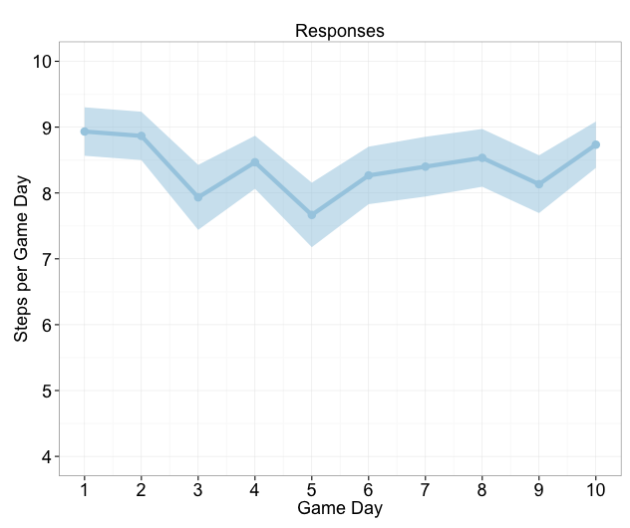
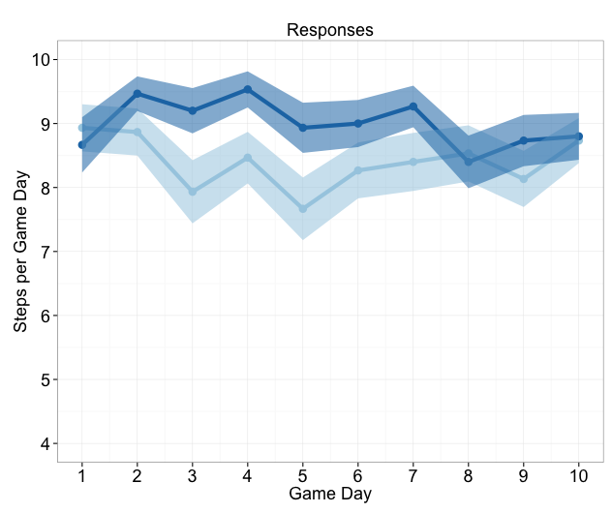
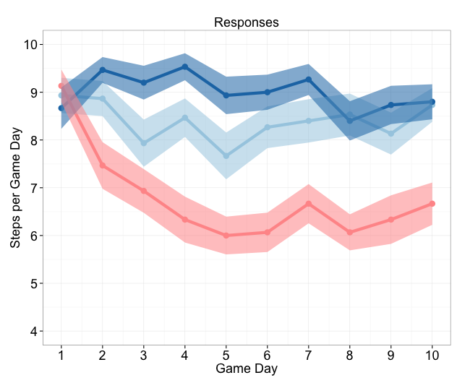
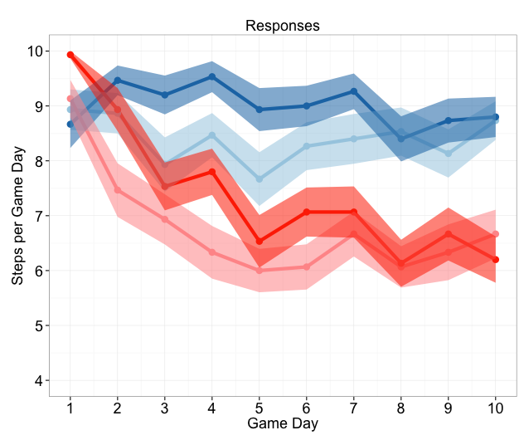

Exp 2: Which conditions were successful?
Reward-Maximizing
(Model-Free)
Reward-Maximizing
(Model-Based)
Action-Signaling
(Uniform Prior)
Action-Signaling
(State-Reward Prior)
Fewer steps = better

Slide 20
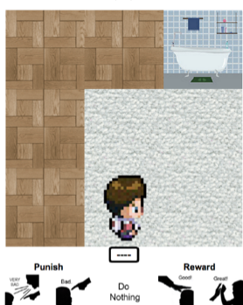
Exp 2: Which conditions were successful?
Reward-Maximizing
(Model-Free)
Reward-Maximizing
(Model-Based)
Action-Signaling
(Uniform Prior)
Action-Signaling
(State-Reward Prior)
Fewer steps = better

Slide 21
Implicit Value Functions
Probably could work, but it begs the question.
Sophisticated literature in behavioral game theory waiting to be united with human-based RL:
E.g., Including equity preferences Fehr and Schmidt (1999)
Value function with beliefs… (see Camerer, 2003)
=> This is putting how people represent the domain into the value function.
Why not study this explicitly?
(aka do psychology/educational sciences?)

Slide 22
Why am I being grumpy?
US federal funding budget for AI/ML is estimated to be ~$6-7 billion.
NSF funding for IIS alone in FY 2022 is requested to be $250 million.
NSF funding for ALL of Behavioral and Cognitive Sciences for FY 2022 is ~$113 million.
Morale: Please be kind to your psychologist colleagues and fund them on your grants.

Slide 23







Acknowledgements
Colleagues and collaborators
Diane Gooding
Tina Winston
Karen Schloss
Shawn Green
Tim Rogers
Jerry Zhu
Alyssa Adams
Kimberly Mueller
Past and Current Austerweil Lab
Jeffrey Zemla
Mohsen Afrasiabi
Xian Liew
Mark Ho
Ian Johnston
Michael Payton
Yun-Shiuan Chuang
Kendra Lange
Anantha Rao
Edward Hubbard
David Salmon
Bertram Malle
Michael Littman
Fiery Cushman
William Heindel
Maryellen MacDonald
Kenneth Kurtz
Yoed Kenett
Jacqueline Erens
Kesong Cao
Sophie Sandweiss
Atulya Reddy
Sam Westby
Nolan Conaway
Blake Chambers
Elise Hopman

